Slide 1
Reproducible Research
Credit Risk Analysis
Presentation focus
Reproducing an R project in Python
How we reproduced the original R workflow in Python, what challenges appeared, how the project is structured, and how another person can run it from GitHub.
Final project presentation · Approx. 20 minutes
Team members
•
Ahmet Hasanov
•
Kuo Zhang
•
Nijat Abiyev
•
Yuceltan Ebiri
GitHub · Python · Documentation · Reproducibility
Notes:
Presenter: Ahmet. Start with a short greeting. Explain that this is a Reproducible Research final project, so the presentation focuses less on proving that the model is perfect and more on showing whether the R project could be reproduced in Python. Mention the four team members and tell the audience that the presentation will cover the original project, the dataset, the translation process, code structure, results, GitHub workflow, and local reproducibility. Aim for about 1 minute.

Slide 2
RR Group Project
What the Course Asked Us to Demonstrate
1. Reproduction process
2. Reproducibility
3. Code quality
Did the reproduction succeed? What was missing? What did not translate directly?
Clear instructions, dependencies, software versions, and a runnable project.
Clean, modular, user-friendly code instead of one long script.
4. Collaboration and Git
5. Presentation and code walkthrough
A project stored in a repository with visible history and meaningful commits from team members.
The project should be presented by the team and should briefly show the code as well.
Our project was designed around these requirements rather than only around model accuracy.
Notes:
Presenter: Ahmet. Explain that the grading criteria shaped the whole project. The main goal was not simply to get the highest possible model accuracy. The main goal was to show the full process: taking an existing R project, reproducing it in Python, documenting what was clear or unclear, and making our own version reproducible. Emphasize that we therefore created a repository, a README, requirements file, and a cleaner modular structure. Aim for about 1.5 minutes.

Slide 3
RR Group Project
Project Objective: From R to Python
Original idea
Python reproduction
•
Start from an existing R analysis
•
Load and inspect the loan dataset
•
Understand its workflow and assumptions
•
Recreate EDA and visualizations
•
Recreate the same logic in Python
•
Train Decision Tree and Random Forest models
Main research/reproduction question
Can the original R-based credit risk analysis be reproduced in Python in a way that is understandable, documented, and runnable by another user?
Notes:
Presenter: Ahmet. Explain the core question of the project. We did not create a completely new research question. We reproduced the logic of an existing R project and translated it into Python. The important part was to preserve the same workflow: data inspection, cleaning, visualizations, encoding, train-test split, decision tree, random forest, and final comparison. Mention that this also helped us see which parts of the R workflow were easy to translate and which parts required adaptation. Aim for about 1.5 minutes.

Slide 4
RR Group Project
Dataset Overview
45,000
14
0
22.2%
observations / rows
variables / columns
missing values at loading
positive loan_status
Main variable groups
Target variable
Applicant profile: age, gender, education, income, employment experience
Loan details: amount, intent, interest rate, percent income
Credit history: credit score, history length, previous defaults
`loan_status` is the classification target. The project predicts whether an applicant belongs to class 0 or class 1 based on borrower and loan characteristics.
The terminal run confirmed that the project loads the dataset successfully and detects the expected columns.
Notes:
Presenter: Kuo. Present the dataset briefly. We have 45,000 records and 14 columns. The variables include personal characteristics, loan-related information, and credit history variables. The target variable is loan_status. In the first run, there were no missing values, which is useful, but we still had to inspect outliers because age and income contained extreme values. Mention that loan_status equals 1 for about 22.2 percent of observations, so the dataset is imbalanced. Aim for about 1.5 minutes.

Slide 5
RR Group Project
Reproduction Process
1
Read original R workflow
2
Translate data loading and EDA
3
Recreate visualizations
4
Adapt cleaning and encoding
5
Rebuild models in Python
6
Refactor into modules + document
python main.py
# project runs the full workflow:
# load → explore → clean → visualize → preprocess → model → compare
Notes:
Presenter: Kuo. Walk through the reproduction process in stages. First we understood the R workflow. Then we translated the data loading, summaries, and visualizations. After that we adapted the cleaning rules and categorical encoding because Python machine learning models need numeric features. Then we rebuilt two models: Decision Tree and Random Forest. Finally, we refactored the direct translation into a modular Python project and made it runnable through main.py. Aim for about 1.5 minutes.

Slide 6
RR Group Project
Code Structure and Short Code Walkthrough
RR_groupproject/
├── main.py
├── requirements.txt
├── README.md
├── data/loan_data.csv
├── outputs/figures/
└── src/
├── data_loader.py
├── explorer.py
├── cleaner.py
├── visualizer.py
├── preprocessor.py
└── models.py
main.py
src/
Runs the complete workflow in order.
Stores reusable classes and functions.
outputs/
README.md
Stores figures generated by the analysis.
Explains the project, reproduction steps, dependencies, and team contributions.
Why modularize?
•
Cleaner than one long script
•
Easier to debug and present
•
Better Git history and teamwork
•
Improves reproducibility
Notes:
Presenter: Kuo. This is the short code presentation slide. Explain that loan.py was the initial direct translation, but the final version is organized around main.py and the src folder. Walk through the modules: data_loader reads the CSV; explorer prints summaries; cleaner handles outliers; visualizer saves plots; preprocessor encodes variables and splits the data; models contains Decision Tree and Random Forest. This structure makes the project cleaner, more reusable, and easier for the teacher to run from the lab computer after pulling from GitHub. Aim for about 2 minutes.

Slide 7
RR Group Project
Reproducibility Setup: GitHub, Requirements, Local Run
GitHub repository
requirements.txt
Virtual environment
Stores code, README, dataset path, outputs, and visible project history.
Lists Python packages needed to reproduce the project locally.
Creates an isolated local Python environment for installing the required packages.
# Clone repository
git clone https://github.com/Kuo629/RR_groupproject.git
cd RR_groupproject
# Create environment and install packages
python -m venv .venv
.venv\Scripts\activate
pip install -r requirements.txt
# Run project
python main.py
This supports reproducibility: another user can clone the repository, install the same dependencies, and run the workflow from main.py.
Notes:
Presenter: Kuo. Explain how someone else can reproduce the project. They clone the repository, create a virtual environment, install the requirements, and run python main.py. This is important because the teacher said the project will be pulled from GitHub and run from a lab computer. The requirements file helps reduce dependency problems, especially when different team members use different systems. Aim for about 1.5 minutes.

Slide 8
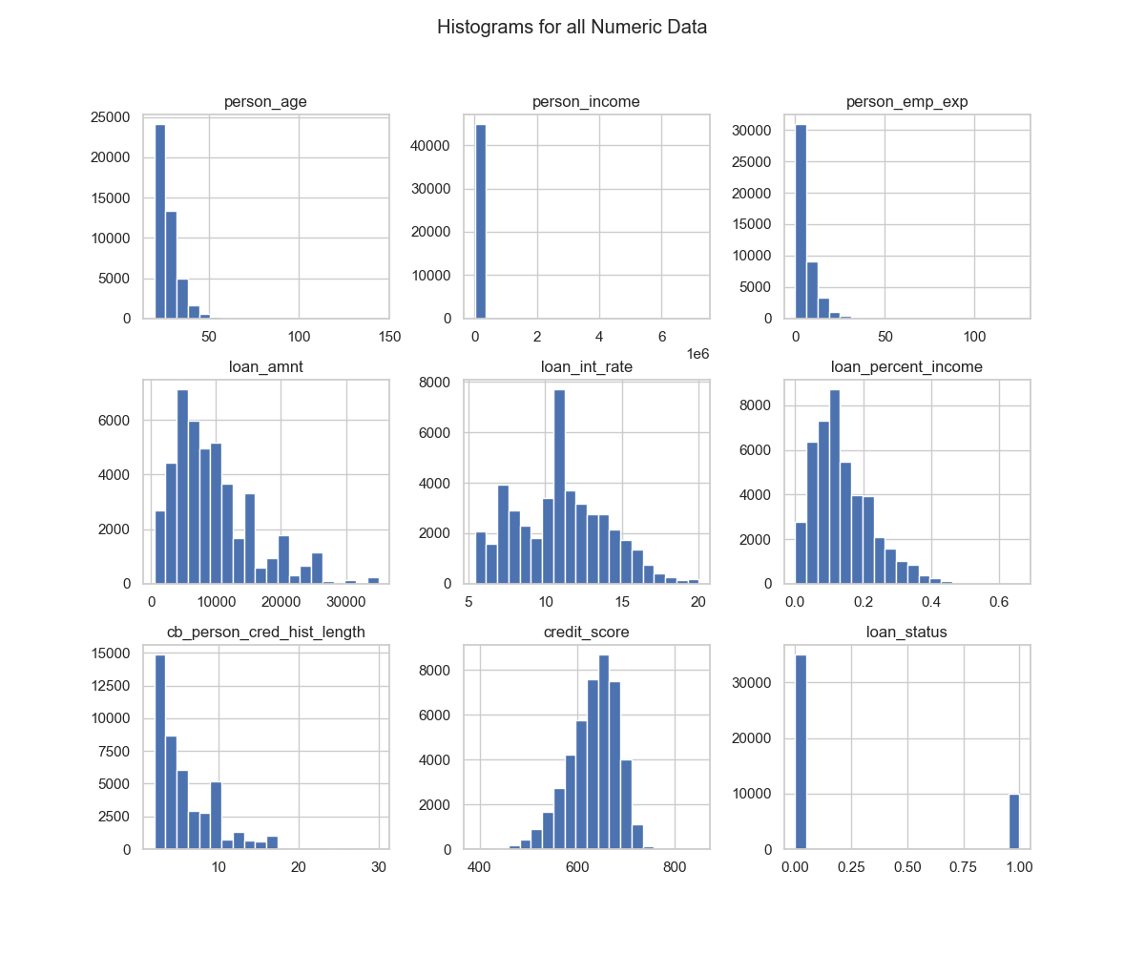
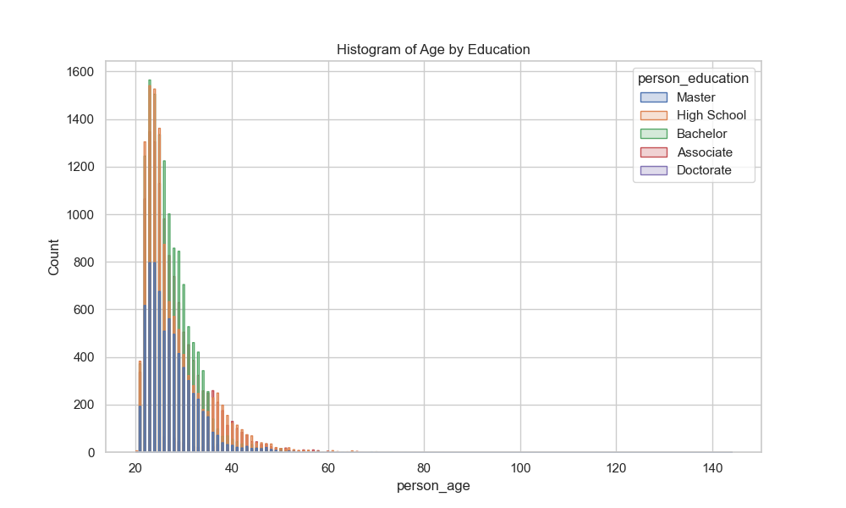
RR Group Project
Exploratory Data Analysis: Numeric Variables
Main observations
Age and employment experience are right-skewed. Loan amount and loan-percent-income also show skewness. Credit score is more centered compared with the other numeric variables.
Notes:
Presenter: Nijat. Explain the numeric exploratory plots. The histograms show that most applicants are younger adults, with age concentrated in the 20s and 30s. Income and loan amount are right-skewed, meaning a small number of observations have much larger values. Loan percent income is also concentrated at lower levels but has a tail. The age by education chart shows similar age patterns across education groups, with most observations in younger age ranges. Aim for about 1.5 minutes.

Slide 9
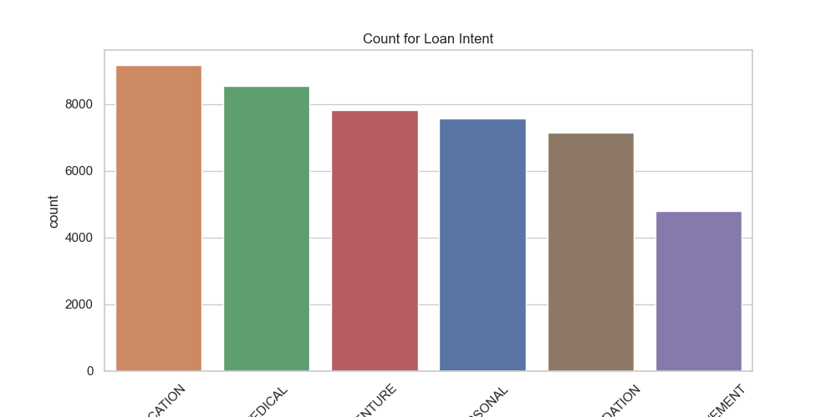
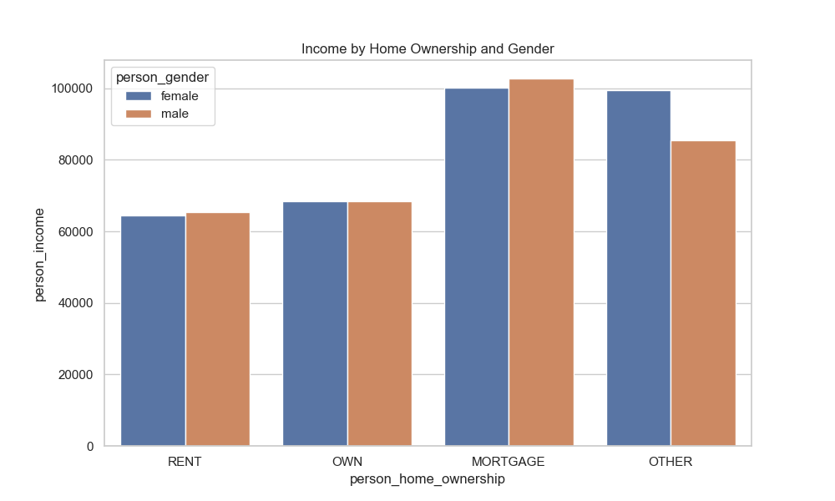
RR Group Project
Exploratory Data Analysis: Categories and Groups
Loan intent
Income and ownership
Education and medical purposes appear among the most common loan reasons, while debt consolidation is lower in this visual output.
Income differs by home ownership category. Mortgage/other groups show higher average income than rent/own groups.
Notes:
Presenter: Nijat. Present the two categorical visualizations. The loan intent chart shows the distribution of reasons for applying for a loan. We do not treat this as a causal result; it is descriptive. The income by home ownership and gender chart shows differences in average income by ownership type. This helped us understand the structure of the data before modeling and identify variables that may be useful predictors. Aim for about 1.5 minutes.

Slide 10
RR Group Project
Cleaning and Preprocessing Decisions
Outlier handling
Categorical encoding
Train-test split
Age > 100, income above the selected threshold, and unrealistic employment experience were replaced with missing values.
String variables were converted using one-hot encoding so that scikit-learn models could read them.
The dataset was split into training and testing sets using a 75/25 split and fixed random seed.
X = pd.get_dummies(
encoded_loan.drop(columns=['loan_status']),
drop_first=True
)
y = encoded_loan['loan_status']
train_test_split(X, y, test_size=0.25, random_state=1234)
These choices translate the R workflow into the Python/scikit-learn format.
Notes:
Presenter: Nijat. Explain that the project was not just copying syntax from R to Python. Some steps had to be adapted to the Python machine learning ecosystem. Scikit-learn requires numeric inputs, so categorical variables had to be encoded. We also used a 75/25 train-test split with a fixed random seed to make the results reproducible. For Random Forest, rows with missing values were dropped before training, similar to the R na.omit approach. Aim for about 2 minutes.

Slide 11
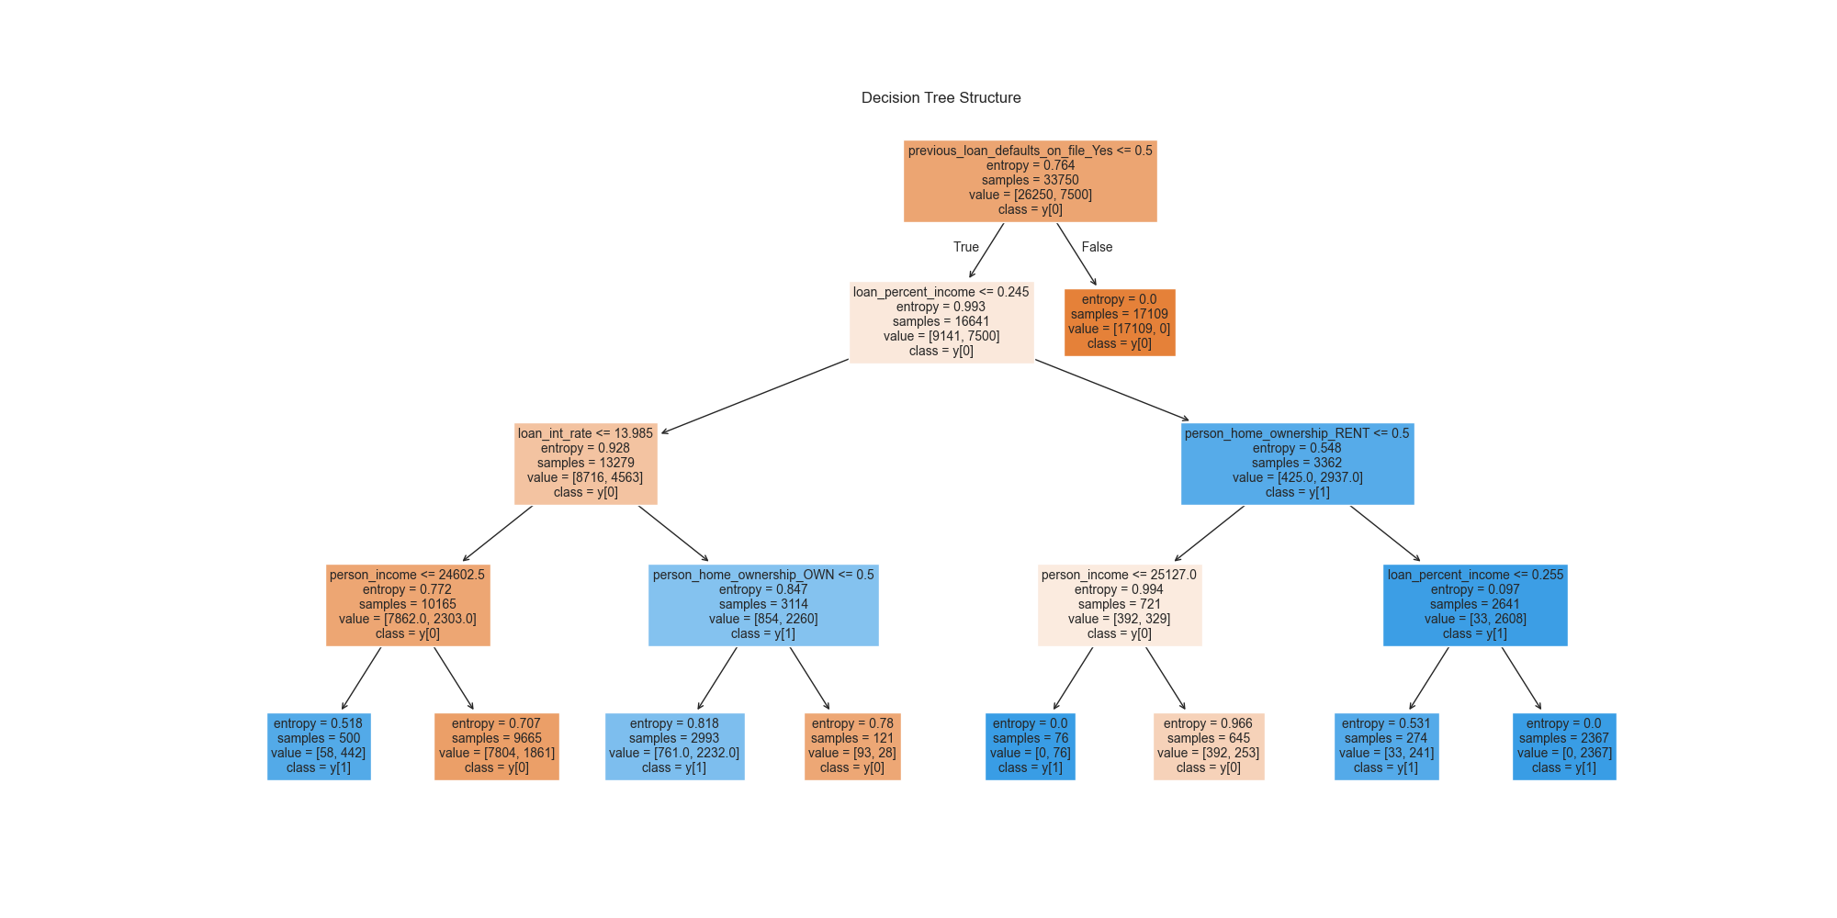
RR Group Project
Model 1: Decision Tree Classifier
90.77%
test accuracy
Why this model?
Decision Trees are interpretable and show which variables split the data.
Important first split
The tree starts with previous loan defaults on file, making it a key predictor.
Notes:
Presenter: Yuceltan. Present the decision tree model. The model is easy to interpret because it shows a visible tree structure. In our result, the first split is based on previous_loan_defaults_on_file, which means previous loan default history is very informative for classification. The Decision Tree achieved 90.77 percent accuracy on the test set. Also mention that interpretability is the strength of this model, but it may be less powerful than an ensemble method. Aim for about 1.5 minutes.

Slide 12
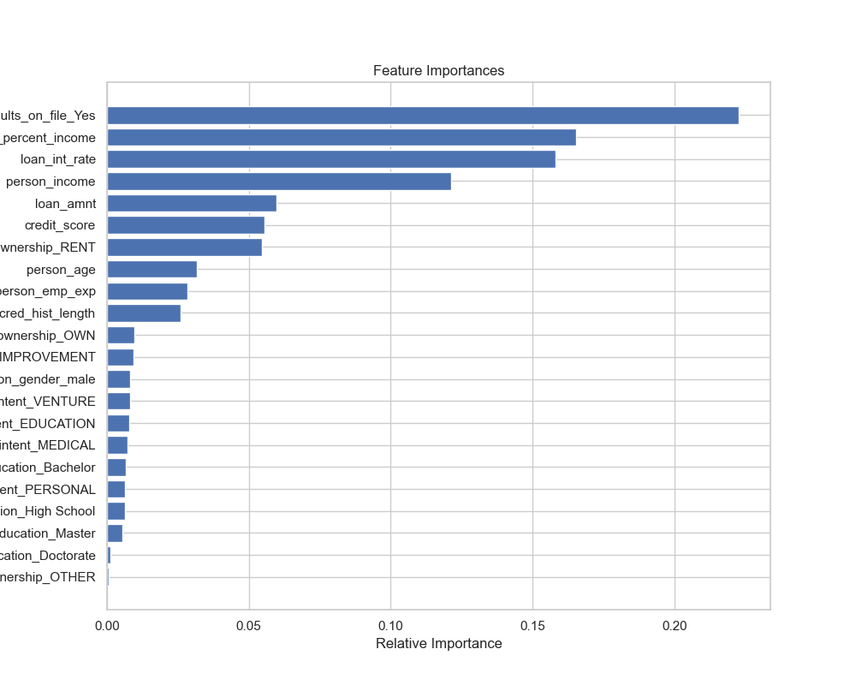
RR Group Project
Model 2: Random Forest Classifier
92.59%
test accuracy
1.00
training accuracy
Feature importance
Previous loan defaults, loan percent income, interest rate, income, and loan amount were among the most important predictors.
The perfect training score suggests that we should mention possible overfitting, even though test accuracy is strong.
Notes:
Presenter: Yuceltan. Explain the Random Forest model as an ensemble of many decision trees. It usually improves predictive performance by combining many trees. In our project, the Random Forest test accuracy was 92.59 percent, which was higher than the Decision Tree. The feature importance plot shows that previous loan defaults, loan percent income, interest rate, income, and loan amount were important variables. Also be honest that the training accuracy was 1.0, which can indicate overfitting, but the test accuracy still remained strong. Aim for about 2 minutes.

Slide 13
RR Group Project
Results Comparison
90.77%
92.59%
+1.82 pp
Decision Tree accuracy
Random Forest accuracy
Random Forest improvement
Decision Tree test matrix
Random Forest test matrix
Final interpretation
[[8464, 286],
[ 752,1748]]
[[8519, 230],
[ 604,1896]]
Random Forest performed better on the test set, while Decision Tree remained useful for explaining the classification logic.
Result: Random Forest had the best test accuracy, but reproducibility and documentation remain the main course focus.
Notes:
Presenter: Yuceltan. Compare the two models. Decision Tree achieved 90.77 percent test accuracy, while Random Forest achieved 92.59 percent. The improvement is about 1.82 percentage points. Explain that Random Forest predicted more class 1 cases correctly than the Decision Tree, based on the confusion matrices. However, also mention that for this course, the model comparison is not the only result. The stronger result is that the project can be reproduced and explained. Aim for about 1.5 minutes.

Slide 14
RR Group Project
Challenges, Lessons, and Final Conclusion
Translation challenges
Reproducibility challenges
Environment challenge
R plots and Python plots do not always have direct equivalents. We had to adjust formatting and plotting functions.
The original project did not fully separate cleaning, visualization, and modeling, so we reorganized the workflow.
We used requirements.txt and a local virtual environment. Because there was no containerized setup, clear installation steps were especially important.
Team contribution summary
•
Ahmet Hasanov: documentation and presentation support, environment setup
•
Kuo Zhang: repository setup and project coordination
•
Nijat Abiyev: dataset review, testing, and result checking, ML models
•
Yuceltan Ebiri: Python translation, modularization
Conclusion: the R workflow was successfully reproduced in Python and organized into a cleaner, documented, and runnable project.
Notes:
Presenter: Yuceltan. Close the presentation. Summarize the main challenges: not every R visualization translated directly, categorical encoding had to be made explicit, and the project had to be reorganized to be reproducible. Then mention team contributions. End with the final conclusion: the R workflow was successfully reproduced in Python, the code was cleaned into modules, the results were generated, and the project can be run from GitHub using a local Python environment. Aim for about 2 minutes, then invite questions.

